Slide 1
Virtual Private Networks
Samuel Barnes, Ian Schwartz, Jack Stoetzel

Slide 2
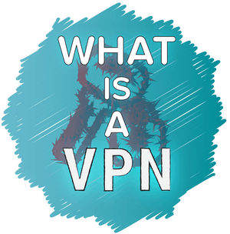
What is a VPN?
A virtual private network is an extension of a private network across a public network that enables users to send and receive data across shared or public networks.
Connecting to a virtual private network allows for a secure connection to a public network for the end user through encryption.

Slide 3
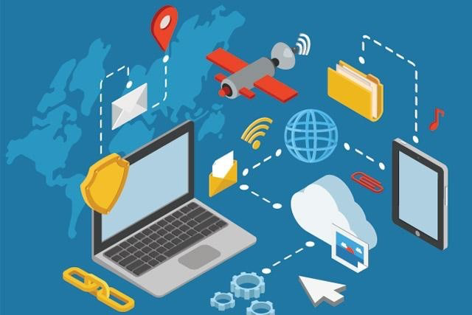
Uses
One of the main uses to virtual private networks is allowing companies to communicate with their fellow employees without having to be on the same network or in the same building as you.
Another use for virtual private networks that has become more popular is the everyday user wanting to protect their data by using a virtual private network to freely browse the internet without the many dangers of publically surfing the internet.

Slide 4
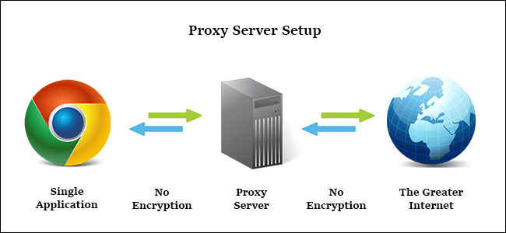
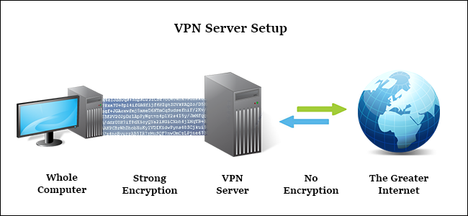
VPN vs. Proxy Server

Slide 5
History of Virtual Private Networks
The first virtual private network was created in 1996 by an employee at Microsoft during the creation of the Peer to Peer Tunneling Protocol (PPTP).
Virtual private networks were originally created and used only by big corporations for their personal goals which made accessibility to the end user difficult.
Companies needed a secure way to share files and communicate with others within the company from different locations.
The previous issues were the security of sharing files that were important to others without a virtual private network.

Slide 6
History (cont’d)
Users needed a safe way to share their files and communicate without the threat of hackers stealing sensitive data and accessing information that is private to big companies.
Virtual private networks solved this issue and allowed for a secure access of important files from virtually anywhere with the use of VPN’s.
At the beginning stages of virtual private networks, encryption methods were weak and could easily be broken by someone with previous knowledge.

Slide 7
Point - to - Point Tunneling Protocol (PPTP)

Slide 8
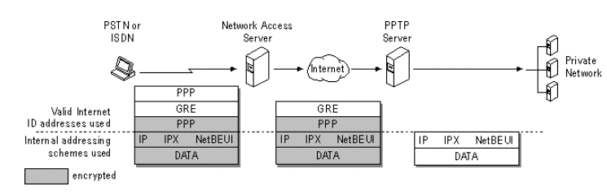
Background
PPTP was one of the first virtual private network protocols developed and founded by Microsoft and quickly became the standard for virtual private networks.
PPTP is more than 20 years old and is still one of the top choices for large businesses due to its pre installation on devices and platforms.
The only thing needed to setup is a username, password, and server address.

Slide 9
How it Works
PPTP encapsulates network protocol datagrams within an IP envelope.
After encapsulated, the router treats it as an IP packet allowing for many different protocols to be routed.
From then on, every encounter treats the data as an IP packet and once received by the PPTP server, forwards to the web or the destination service.
Connection is established by communicating with the peer on TCP port 1723, the connection is used to establish and manage the encapsulating tunnel to the same peer.
Each end of the tunnel is used to authenticate and the data being sent through.

Slide 10
PPTP Security Level
PPTP was the first protocol for virtual private networks and was therefore one of the weaker protocols
The protocol was easily cracked when it was first created so there was a need to upgrade the security of the protocol
By upgrading the bit encryption, the protocol is slightly safer now, but still not as safe as the more popular protocols used today

Slide 11
Pros and Cons
Extremely fast
Easy to setup and configure on most OS
High rate of cross platform compatibility
Encryption is sub par and not suitable for securing online data
Connection can be exploited by hackers
Routers with PPTP Passthrough is usually required
Connection can easily be blocked by firewalls

Slide 12
Layer Two Tunneling Protocol (L2TP)

Slide 13
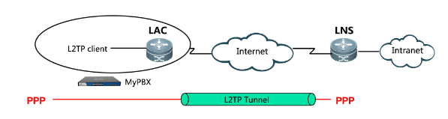
How it Works
L2TP defines an extension to PPTP that an internet service provider uses to allow a virtual private network to operate.
The combination of L2F from Cisco and PPTP from Microsoft allows a single protocol to operate as a virtual private network.
The L2TP initiates a tunnel between an LAC and an LNS on the Internet to enable a Point-to-Point Protocol (PPP) link layer to be encapsulated and then carried across the Internet.
The end user initiates a PPP connection to an internet service provider through either an ISDN or PSTN service.

Slide 14
How it Works (cont’d)
During the connection process, the respective internet service provider conducts partial authentication in order to gain the connected users username.
Once the username has been collected, the information of the username can be used to grant access based on the user.
A free slot is then assigned within the network to accept or reject the connection.

Slide 15
Uses
L2TP is primarily used to integrate multi protocol dial up services into an existing internet service providers point of presence.
The protocol is commonly used however, to resell ADSL endpoint and cable connectivity by being located between the end user and the internet service provider.
Because this sits between the end user and the ISP, the reselling provider does not seem to be the one doing the transport.

Slide 16
Security Level
L2TP’s extension of PPTP utilizes a process called double encapsulation where the first encapsulation establishes a PPP connection while the second contains the IPSec encryption.
L2TP supports AES-256 bit encryption algorithms but can slow down the overall performance.
Only uses UDP port 500, so it can easily be blocked by firewalls.
The style of connection prevents the possibility of a middle man hack.

Slide 17
Pros and Cons
Pros:
Available on most all devices
Easy setup
High levels of security
Supports multi threading
Cons:
Can be blocked by firewalls
NSA may have weakened the protocol
Not the fastest due to double encapsulation

Slide 18
Secure Socket Tunneling Protocol (SSTP)

Slide 19
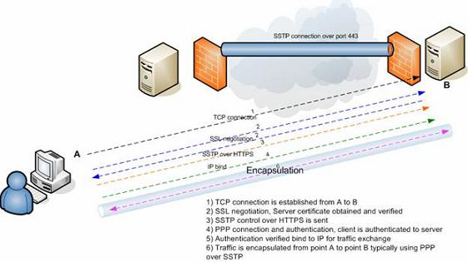
How it Works
SSTP works by establishing a secure connection between a VPN client and a VPN server.
The protocol creates a secure and encrypted tunnel between the client and server to send all data and traffic through.
SSTP transports PPP traffic, but does it through a SSL/TLS channel.

Slide 20
SSTP Security Level
SSTP offers a significantly higher security level than PPTP and the SSL/TLS channel provides secure key negotiation and encryption.
There are a few issues with the protocol including the TCP Meltdown problem
The problem occurs when there is a TCP connection within a TCP connection that causes connectivity issues.
TCP Meltdown is not a huge problem but can cause issues when needed for 24/7 security.

Slide 21
SSTP Pros and Cons
Pros:
Encryption almost on par with OpenVPN
Easily configured
Difficult to block because it uses TCP port 443 which is same as HTTPS
Good speeds if the correct amount of bandwidth is available
Cons:
Closed source and solely owned by Microsoft
Limited number of platforms available- windows, linux, android, and routers
Connection can be dropped if network admin spots the SSTP header
Susceptible to the TCP Meltdown

Slide 22
Internet Key Exchange Version 2 (IKEv2)

Slide 23
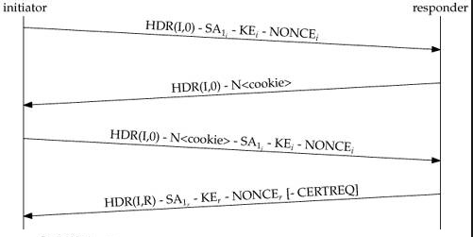
How it Works
IKEv2 has a very high security level after its failing predecessor IKEv1’s many issues with security and encryption.
The protocol dynamically establishes and maintains a shared state between the endpoints of an IP datagram.
Its mobile support allows for mobile security where a user can move from one network to another and still maintain their secure connection without drop.
The IKE security association (SA) uses shared secret information that it stores to establish CHILD-SAs for the encapsulated security payload (ESP) protocol, and defines the cryptographic algorithm to be used by the SAs.

Slide 24
How it Works (cont’d)
The protocol is a request response pair protocol that are referred as exchanges.
The requester ensures reliability and decides to either retransmit or abandon connection.
The four types of exchanges are IKE_SA_INIT, IKE_AUTH, CREATE_CHILD_SA, and INFORMATIONAL.
Once the first two necessary exchanges have been completed, all exchanges can happen in any order necessary.

Slide 25
IKEv2 Pros and Cons
Pros:
Very secure and supports wide range of encryption protocols
Stable even after network connection loss
Easy to set up
One of the fastest protocols
Cons:
Limited platform support
Same drawbacks as IPSec
Can be blocked by firewalls

Slide 26
OpenVPN

Slide 27
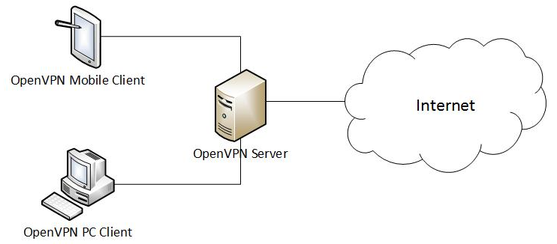
How it Works
OpenVPN is an open source protocol responsible for handling client-server communications by establishing a secure tunnel between the VPN client and the VPN server.
The protocol supports an improved login and authentication processes by using third party plug-ins and scripts.
OpenVPN uses its own custom protocol based on the TLS and SSL and transports data through TCP or UDP.

Slide 28
Security
OpenVPN is one of the safest VPN protocols currently available after undergoing several security audits and only finding minor setbacks that did not endanger user data and bugs that were quickly fixed.
The protocol uses 256 bit encryption of the SSL library to strengthen the security of the connection and can be implemented several different cypher algorithms.
OpenVPN offers a private subnet configuration to connect to servers beyond the OpenVPN server.
OpenVPN relies on TLS-authentication to protect from the vulnerabilities of the internet.

Slide 29
Pros and Cons
Very secure using 256 bit encryption keys and high end cyphers
Easily bypasses many firewalls
Uses both TCP and UDP to offer more control over the connections
Runs on a large number of platforms
Manual setup can be difficult
Can encounter drops in connection due to strong encryption
Requires third party apps to run

Slide 30
Implementation
Implement a Raspberry Pi VPN server on school network (FAILED - due to school network)
Use a personal router to set it up between two school computers (FAILED - due to admin restrictions)
Simulation of a VPN

Slide 31
Works Cited
“IKEv2 VPN - What Is IKEv2 & Benefits of IKEv2 Protocol.” Img, www.purevpn.com/what-is-vpn/protocols/ikev2.
“Layer 2 Tunneling Protocol.” Wikipedia, Wikimedia Foundation, 10 Apr. 2019, en.wikipedia.org/wiki/Layer_2_Tunneling_Protocol.
Mocan, Tim. “What Is IKEv2? (Your Guide to the IKEV2 VPN Protocol).” CactusVPN, 20 Feb. 2019, www.cactusvpn.com/beginners-guide-to-vpn/what-is-ikev2/.
Mocan, Tim. “What Is L2TP (Layer 2 Tunneling Protocol)?” CactusVPN, 25 Feb. 2016, www.cactusvpn.com/beginners-guide-to-vpn/what-is-l2tp/.

Slide 32
Citations (cont’d)
Mocan, Tim. “What Is OpenVPN & How Does OpenVPN Work?” CactusVPN, 1 Feb. 2019, www.cactusvpn.com/beginners-guide-to-vpn/what-is-openvpn/#safety.
Mocan, Tim. “What Is PPTP? (Everything You Need to Know).” CactusVPN, 22 Jan. 2019, www.cactusvpn.com/beginners-guide-to-vpn/what-is-pptp/.
Mocan, Tim. “What Is SSTP? (Your Guide to the SSTP VPN Protocol).” CactusVPN, 5 Feb. 2019, www.cactusvpn.com/beginners-guide-to-vpn/what-is-sstp/.
“Secure Socket Tunneling Protocol.” Wikipedia, Wikimedia Foundation, 11 Apr. 2019, en.wikipedia.org/wiki/Secure_Socket_Tunneling_Protocol.

Slide 33
Citations (cont’d)
“Virtual Private Network.” Wikipedia, Wikimedia Foundation, 2 May 2019, en.wikipedia.org/wiki/Virtual_private_network.
“VPN Software Solutions & Services For Business.” OpenVPN, openvpn.net/.
“What Is L2TP VPN And How To Setup L2TP with VPN.” What Is L2TP VPN And How To Setup L2TP with VPN, www.purevpn.com/what-is-vpn/protocols/l2tp.
“What Is PPTP And How To Setup a PPTP VPN.” What Is PPTP And How To Setup a PPTP VPN, www.purevpn.com/what-is-vpn/protocols/pptp.
“What Is SSTP And How To Setup VPN With SSTP.” PureVPN, www.purevpn.com/what-is-vpn/protocols/sstp.

Slide 34
Comments/Questions

Slide 35
Matching Quiz
L2TP
OpenVPN
SSTP
PPTP
IKEv2

